Slide 1
Cloud Application Architecture Styles
Session 01
Nabajyoti Boruah
Azure Solutions Architect
Session 06

Slide 2
Agenda
Cloud Architecture styles
Benefits | Constraints | Challenges
Azure Implementation
Q & A

Slide 3
Prerequisites
Experience on operating systems, virtualization, cloud infrastructure, storage structures, governance, networking and application infrastructure.
With Understanding of resilience and disaster recovery, including backup and restore operations.

Slide 4
Azure Architects Role
Skills include recommending solutions for logging, multi-factor authentication, SSO, hybrid identity, backup and recovery, containers, microservices, monitoring, automation, storage, networking, and application infrastructure.
Translate business requirements into productive Solution.

Slide 5
Objectives
This session presents a structured approach for designing and architecting applications on Azure that are scalable, secure, resilient, and highly available.
It is based on proven practices that we have learned from customer engagements.

Slide 6
Architecture Styles

Slide 7
N-tier
N-tier is a traditional architecture for enterprise applications.
Dependencies are managed by dividing the application into layers that perform logical functions, such as presentation, business logic, and data access.
N-tier is a natural fit for migrating existing applications that already use a layered architecture.
N-tier is most often seen in infrastructure as a service (IaaS) solutions, or application that use a mix of IaaS and managed services.

Slide 8
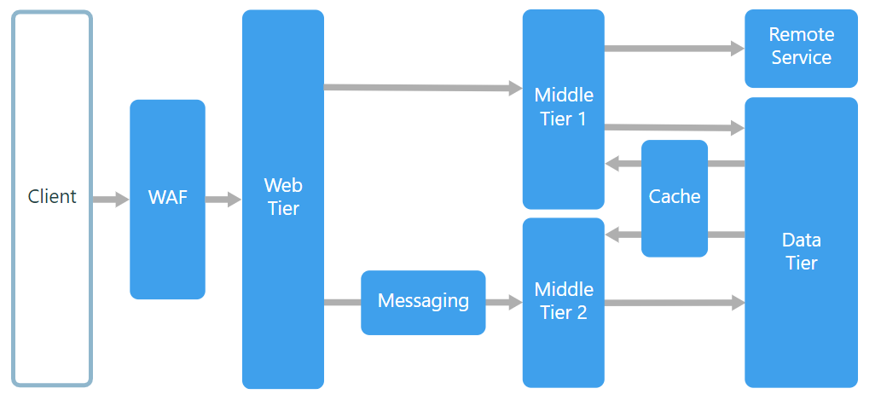
N-tier

Slide 9
When to use this architecture
Simple web applications.
Migrating an on-premises application to Azure with minimal refactoring.
Unified development of on-premises and cloud applications.

Slide 10
Benefits
Portability between cloud and on-premises, and between cloud platforms.
Less learning curve for most developers.
Natural evolution from the traditional application model.
Open to heterogeneous environment (Windows/Linux)

Slide 11
Challenges
Monolithic design prevents independent deployment of features.
Managing an IaaS application is more work than an application that uses only managed services.
It can be difficult to manage network security in a large system.

Slide 12
N-tier architecture on virtual machines

Slide 13
Web-Queue-Worker
The core components of this architecture are a web front end that serves client requests, and a worker that performs resource-intensive tasks, long running workflows, or batch jobs.
The web front end communicates with the worker through a message queue.

Slide 14
Web-Queue-Worker

Slide 15
When to use this architecture
Applications with a relatively simple domain.
Applications with some long-running workflows or batch operations.
When you want to use managed services, rather than infrastructure as a service (IaaS).

Slide 16
Benefits
Relatively simple architecture that is easy to understand.
Easy to deploy and manage.
Clear separation of concerns.
The front end is decoupled from the worker using asynchronous messaging.
The front end and the worker can be scaled independently.

Slide 17
Challenges
Without careful design, the front end and the worker can become large, monolithic components that are difficult to maintain and update.
There may be hidden dependencies, if the front end and worker share data schemas or code modules.

Slide 18
Web-Queue-Worker on Azure App Service

Slide 19
Microservices
A microservices architecture consists of a collection of small, autonomous services.
Each service is self-contained and should implement a single business capability.

Slide 20
Microservices

Slide 21
When to use this architecture
Large applications that require a high release velocity.
Complex applications that need to be highly scalable.
Applications with rich domains or many subdomains.
An organization that consists of small development teams.

Slide 22
Benefits
Independent deployments.
You can update a service without redeploying the entire application, and roll back or roll forward an update if something goes wrong. Bug fixes and feature releases are more manageable and less risky.
Independent development.
A single development team can build, test, and deploy a service. The result is continuous innovation and a faster release cadence.

Slide 23
Benefits
Small, focused teams.
Teams can focus on one service. The smaller scope of each service makes the code base easier to understand, and it’s easier for new team members to ramp up.
Fault isolation.
If a service goes down, it won’t take out the entire application. However, that doesn’t mean you get resiliency for free. You still need to follow resiliency best practices and design patterns.

Slide 24
Benefits
Mixed technology stacks.
Teams can pick the technology that best fits their service.
Granular scaling.
Services can be scaled independently.

Slide 25
Challenges
Complexity.
A microservices application has more moving parts than the equivalent monolithic application. Each service is simpler, but the entire system as a whole is more complex.
Development and testing.
Writing a small service that relies on other dependent services requires a different approach than a writing a traditional monolithic or layered application.
Lack of governance.
The decentralized approach to building microservices has advantages, but it can also lead to problems. You may end up with so many different languages and frameworks that the application becomes hard to maintain.

Slide 26
Challenges
Network congestion and latency.
The use of many small, granular services can result in more interservice communication. Also, if the chain of service dependencies gets too long (service A calls B, which calls C...), the additional latency can become a problem.
Data integrity.
With each microservice responsible for its own data persistence. As a result, data consistency can be a challenge. Embrace eventual consistency where possible.
Management.
To be successful with microservices requires a mature DevOps culture. Correlated logging across services can be challenging. Typically, logging must correlate multiple service calls for a single user operation.

Slide 27
Challenges
Versioning.
Updates to a service must not break services that depend on it. Multiple services could be updated at any given time, so without careful design, you might have problems with backward or forward compatibility.
Skill set.
Microservices are highly distributed systems. Carefully evaluate whether the team has the skills and experience to be successful.

Slide 28
Microservices using Azure Container Service

Slide 29
Microservices using Azure Service Fabric

Slide 30
CQRS
Command and Query Responsibility Segregation (CQRS) is an architecture style that separates read operations from write operations.

Slide 31
CQRS

Slide 32
When to use this architecture
Consider CQRS for collaborative domains where many users access the same data, especially when the read and write workloads are asymmetrical.
CQRS is not a top-level architecture that applies to an entire system. Apply CQRS only to those subsystems where there is clear value in separating reads and writes. Otherwise, you are creating additional complexity for no benefit.

Slide 33
Benefits
Independently scaling.
CQRS allows the read and write workloads to scale independently, and may result in fewer lock contentions.
Optimized data schemas.
The read side can use a schema that is optimized for queries, while the write side uses a schema that is optimized for updates.
Security.
It’s easier to ensure that only the right domain entities are performing writes on the data.

Slide 34
Challenges
Complexity.
The basic idea of CQRS is simple. But it can lead to a more complex application design, especially if they include the Event Sourcing pattern.
Messaging.
Although CQRS does not require messaging, it’s common to use messaging to process commands and publish update events. In that case, the application must handle message failures or duplicate messages.
Eventual consistency.
If you separate the read and write databases, the read data may be stale.

Slide 35
CQRS in microservices

Slide 36
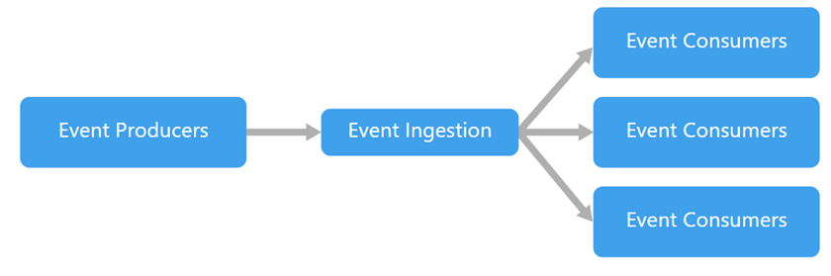
Event-driven
An event-driven architecture consists of event producers that generate a stream of events, and event consumers that listen for the events.

Slide 37
When to use this architecture
Multiple subsystems must process the same events.
Real-time processing with minimum time lag.
Complex event processing, such as pattern matching or aggregation over time windows.
High volume and high velocity of data, such as IoT.

Slide 38
Benefits
Producers and consumers are decoupled.
No point-to-point integrations. It's easy to add new consumers to the system.
Consumers can respond to events immediately as they arrive.
Highly scalable and distributed.
Subsystems have independent views of the event stream.

Slide 39
Challenges
Guaranteed delivery.
In some systems, especially in IoT scenarios, it's crucial to guarantee that events are delivered.
Processing events in order or exactly once.
Each consumer type typically runs in multiple instances, for resiliency and scalability. This can create a challenge if the events must be processed in order (within a consumer type), or if the processing logic is not idempotent.

Slide 40
IoT architecture on Azure

Slide 41
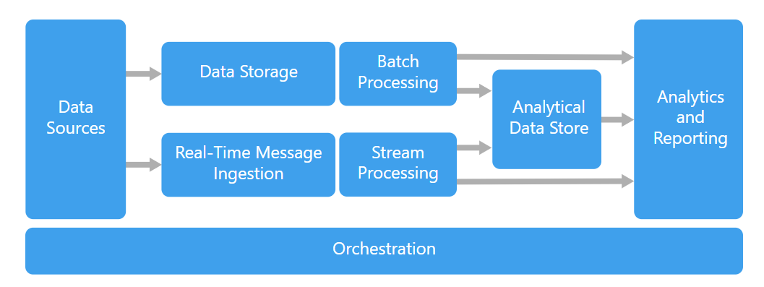
Big data
A big data architecture is designed to handle the ingestion, processing, and analysis of data that is too large or complex for traditional database systems.

Slide 42
Benefits
Technology choices.
You can mix and match Azure managed services and Apache technologies in HDInsight clusters, to capitalize on existing skills or technology investments.
Performance through parallelism.
Big data solutions take advantage of parallelism, enabling high-performance solutions that scale to large volumes of data.

Slide 43
Benefits
Elastic scale.
All of the components in the big data architecture support scale-out provisioning, so that you can adjust your solution to small or large workloads, and pay only for the resources that you use.
Interoperability with existing solutions.
The components of the big data architecture are also used for IoT processing and enterprise BI solutions, enabling you to create an integrated solution across data workloads.

Slide 44
When to use this architecture
Store and process data in volumes too large for a traditional database.
Transform unstructured data for analysis and reporting.
Capture, process, and analyze unbounded streams of data in real time, or with low latency.
Use Azure Machine Learning or Microsoft Cognitive Services.

Slide 45
Challenges
Complexity.
Big data solutions can be extremely complex, with numerous components to handle data ingestion from multiple data sources. It can be challenging to build, test, and troubleshoot big data processes.
Skillset.
Many big data technologies are highly specialized, and use frameworks and languages that are not typical of more general application architectures.
Technology maturity.
Many of the technologies used in big data are evolving. While core Hadoop technologies such as Hive and Pig have stabilized, emerging technologies such as Spark introduce extensive changes and enhancements with each new release.

Slide 46
Challenges
Security.
Big data solutions usually rely on storing all static data in a centralized data lake.

Slide 47
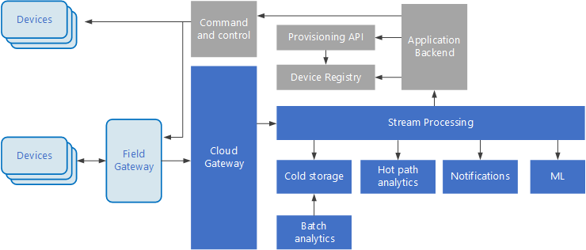
Internet of Things (IoT) is a specialized subset of big data solutions.

Slide 48
Big compute
The term big compute describes large-scale workloads that require a large number of cores, often numbering in the hundreds or thousands.
Scenarios include image rendering, fluid dynamics, financial risk modeling, oil exploration, drug design, and engineering stress analysis, among others.

Slide 49
Big compute

Slide 50
When to use this architecture
Computationally intensive operations such as simulation and number crunching.
Simulations that are computationally intensive and must be split across CPUs in multiple computers (10-1000s).
Simulations that require too much memory for one computer, and must be split across multiple computers.

Slide 51
When to use this architecture
Long-running computations that would take too long to complete on a single computer.
Smaller computations that must be run 100s or 1000s of times, such as Monte Carlo simulations.

Slide 52
Benefits
High performance with parallel processing.
Can harness hundreds or thousands of computer cores to solve large problems faster.
Access to specialized high-performance hardware, with dedicated high-speed InfiniBand networks.
You can provision VMs as needed to do work, and then tear them down.

Slide 53
Challenges
Managing the VM infrastructure.
Managing the volume of number crunching.
Provisioning thousands of cores in a timely manner.
For tightly coupled tasks, adding more cores can have diminishing returns. You may need to experiment to find the optimum number of cores.

Slide 54
Big compute using Azure Batch

Slide 55
Learning
An architecture style places constraints on the design, which guide the “shape” of an architecture style by restricting the choices.
These constraints provide both benefits and challenges for the design. Use the information in this session to understand what the trade-offs are when adopting any of these styles.

Slide 56
Summery
We have identified a set of architecture styles that are commonly found in cloud applications. That includes following points
A description and logical diagram of the style.
Recommendations for when to choose this style.
Benefits, challenges, and best practices.
A recommended deployment using relevant Azure services.

Slide 57
Thank You !!
Q & A

Slide 58

Design Challenge

